Slide 1
IDEA – FiN SMART-LEND
Innovation with PSD2 – INSTANT Digital Lending in Covid Times

Slide 2
Fin Smart-Lend
Key Actors and their Business Value Proposition
Lending Firms
Customers
Enables customers to avail customized loans for their requirements
Enables customers without credit history to secure loans based on their current financial health
Provides unparalleled convenience to customers by allowing them to evaluate loans from multiple lenders in a single platform
Assess eligibility on latest financial status accessed through PSD2
Leverage conventional & alternative data points to assess risk profile
Continuously monitor customer’s repayment risk by monitoring client’s financial status through PSD2
Collaborate with other fintech (viz. AISP, Payment agencies etc.) to provide best product & experience to customers and focus on core competency
Loan Aggregator
FFDC Platform
Faster time to market through reduced integration efforts with lenders and fintech
Ready customer base since multiple banks are hosted in FFDC platform and using Finastra’s retail lending products
Collaborate with other fintech firms to provide best of breed solution to customers
Enrich the platform with key players in lending ecosystem. Establish a collaborative eco-system for easy integration of new fin-techs in the value chain
Generate a consistent revenue stream for platform by supporting an end-to-end use case
Transform the experience of Finastra clients and partners and emerge as a leading Fintech platform in the world

Slide 3







Fin Smart-Lend
Smart Loan Origination Process – Customers | Lender Banks | PSD2 Partners | FFDC
Loan Request + PSD2 Consent (Customer)
Loan Decisioning - Digital Cashflows
(Banks)
Repayment Stress Monitoring
(Banks)
Customer’s Request for Loan – Amount, Tenure & Bank Account
CONSENT to Share Account Information with Lender Banks
CONSENT to Monitor Accounts & Transactions for 12 Months
Real-time Transaction History and Balances (via PSD2 consent) used for Income/Expense Analysis
Completely Digital Loan Eligibility Check through real-time Cashflows and Rules Workflow
Post Loan Disbursement, Enable continuous monitor of stress on Accounts for Repayment Risk
Historical Credit Risk Ratings would no longer be relevant in COVID times
1
2
3
4
5
Aggregated Loan Offers**
Digital Loan Disbursement
(Banks & Payment Processing Agencies to Customer)
Customer’s Loan Request is sent to all Participating Lender Banks
Loan Offers are aggregated and sent to customer with Repayment Projections
Customer selects Preferable Loan Offer
Digital Signature on Loan Terms & Condition
Loan Account Creation and Disbursement using FFDC Retail Banking Open APIs
Payment Mandates set on Loan Repayment Account
Notes:
E-Signature at dealer goes direct into Fusion Essence
Structured data feeds in via APIs
Dealer PDF contract posted into Document Management
Scanned OCR data goes direct into Fusion Essence
Structured data feeds in via APIs
Scan barcodes for paper contracts received

Slide 4
Fin Smart-Lend
Key Benefits accrued through the value chain
Instant Digital Loan Origination
Enables customers to select best suited offer and instantly create a loan account
Enables lending firm to disburse loan amount to customers in near real time basis
Generate Personalized Loan Offers for Customers (Great User Experience)
Enables lending firms to generate loan offers based on customer’s current financial position
Enables lending firms to tailor loan schedule based on customer preference
Enables the aggregator fintech to create unparalleled experience for customer with entire process being automated and executed in minutes
Accurately Assess and Monitor Customer Risk
Enables lending firm to evaluate customer risk at the time of loan origination using conventional and alternative data points
Enables lending firm to build a holistic picture of customer’s financial health by accessing information through AISP providers (PSD2)
Enables lending firm to continuously monitor customer risk by accessing his financial information through AISP (PSD2)

Slide 5
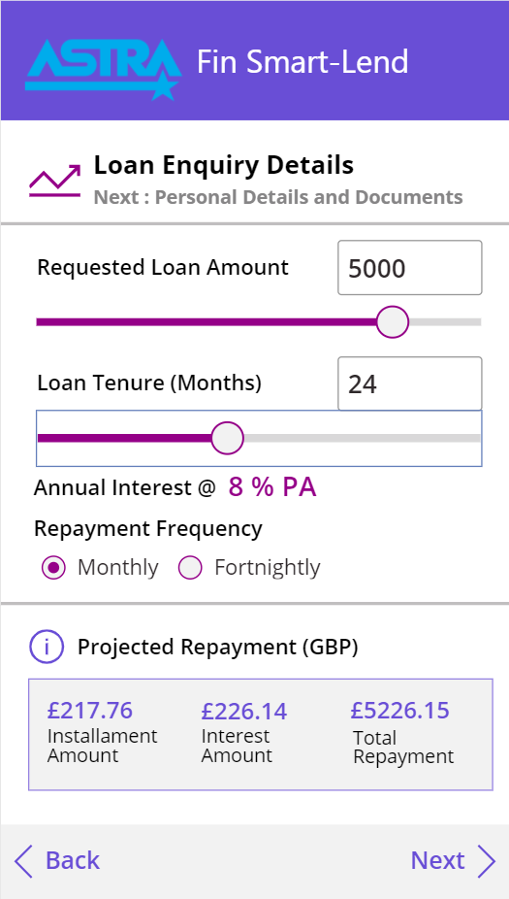
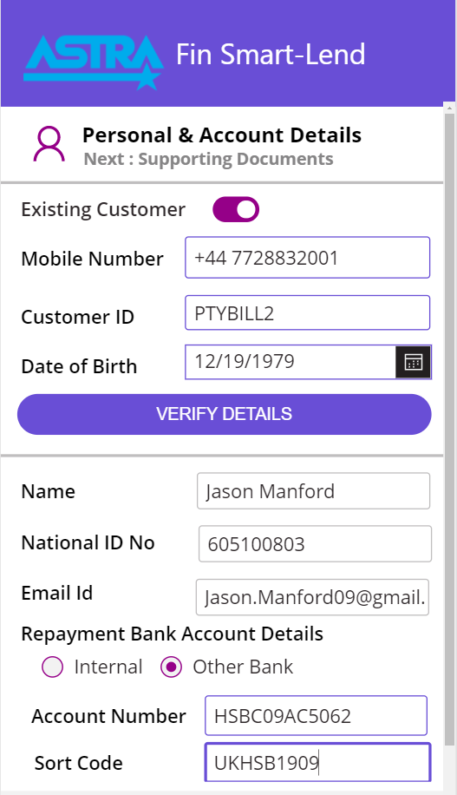
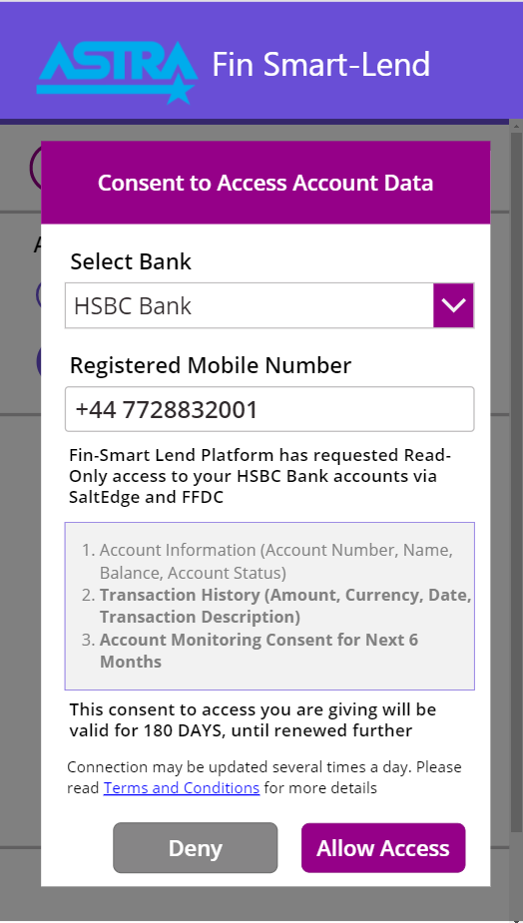
Fin Smart-Lend
Smart Loan Origination Process – Customers | Lender Banks | PSD2 Partners | FFDC
1.1
Customer Loan Request
1.2
2
Loan Application Details
PSD2 Account Monitoring Consent
Notes:
E-Signature at dealer goes direct into Fusion Essence
Structured data feeds in via APIs
Dealer PDF contract posted into Document Management
Scanned OCR data goes direct into Fusion Essence
Structured data feeds in via APIs
Scan barcodes for paper contracts received

Slide 6
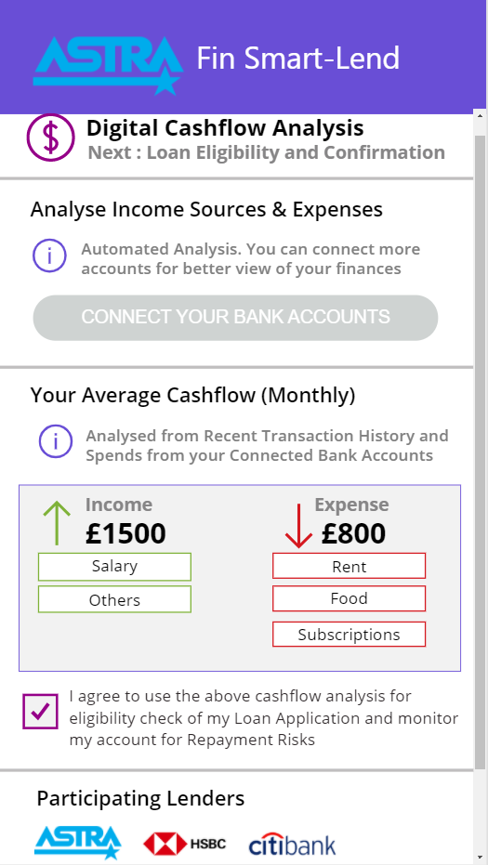
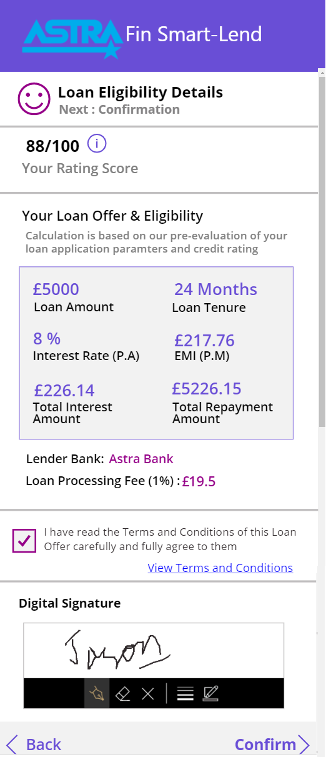
Fin Smart-Lend
Smart Loan Origination Process – Customers | Lender Banks | PSD2 Partners | FFDC
3
4
Digital Cashflows using PSD2
Aggregator Model (Lender Banks)
Loan Eligibility Check and Offer from Lender Bank
Digital Signature & Agreement Confirmation
Notes:
E-Signature at dealer goes direct into Fusion Essence
Structured data feeds in via APIs
Dealer PDF contract posted into Document Management
Scanned OCR data goes direct into Fusion Essence
Structured data feeds in via APIs
Scan barcodes for paper contracts received

Slide 7
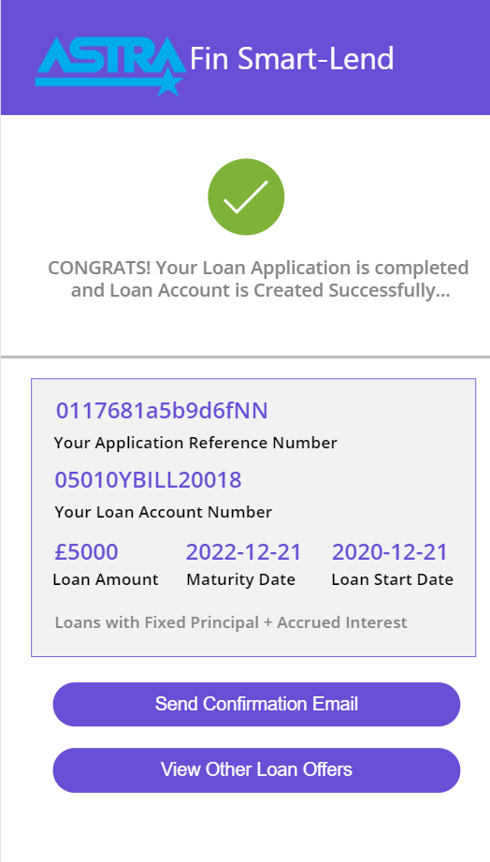
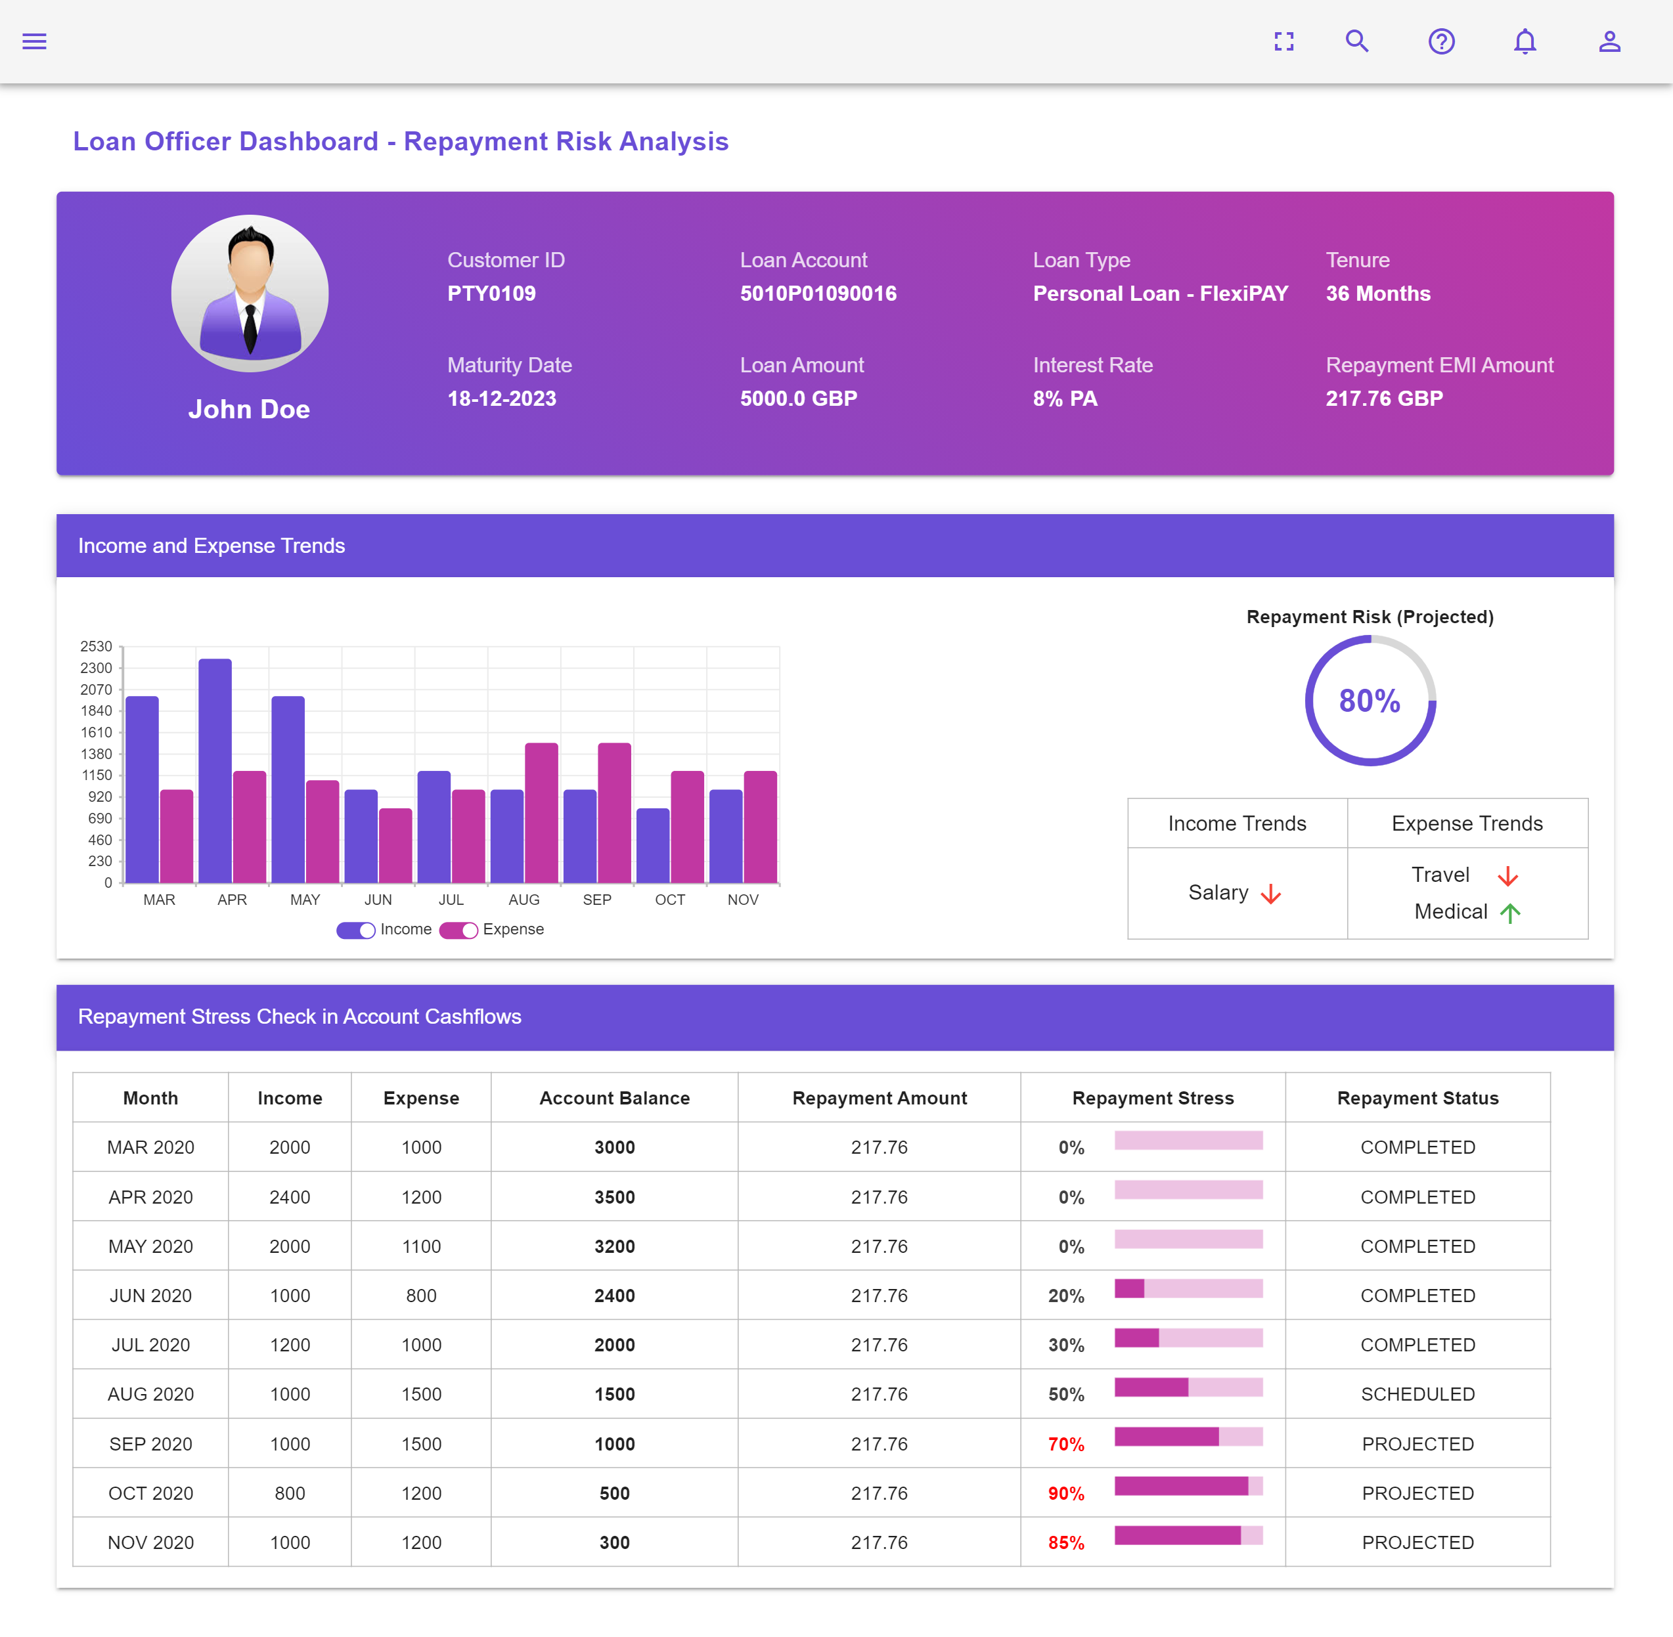
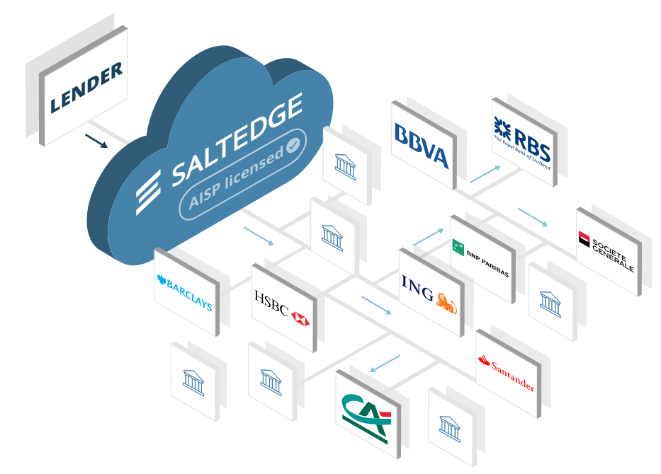
Fin Smart-Lend
Smart Loan Origination Process – Customers | Lender Banks | PSD2 Partners | FFDC
Digital Loan Disbursement – FFDC APIs
5
Monitor Repayment Risk/Stress in Real-time (Banks)
PSD2 FFDC Partner - SaltEdge
Notes:
E-Signature at dealer goes direct into Fusion Essence
Structured data feeds in via APIs
Dealer PDF contract posted into Document Management
Scanned OCR data goes direct into Fusion Essence
Structured data feeds in via APIs
Scan barcodes for paper contracts received

Slide 8

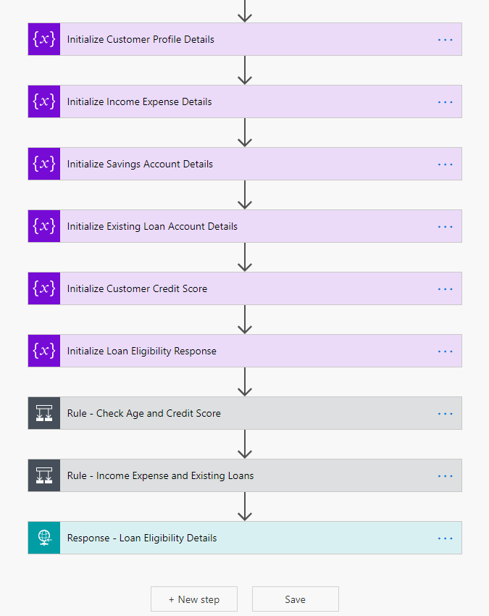




USE OF TECHNOLOGIES | FFDC OPEN APIs | FFDC PARTNERS
Technologies
FFDC – Open APIs
Microsoft Power Apps
Microsoft Flows
VueJS
NodeJS
Fusion Essence Open APIs
Customer Onboarding
Accounts Information
Loans
Payment Mandates
FFDC Partners Usage
PSD2
Digital Cashflow Analysis
*** Configurable Loan Decisioning Rules Workflow using Microsoft Flows and Power Apps
*** For Prototype Development

Slide 9
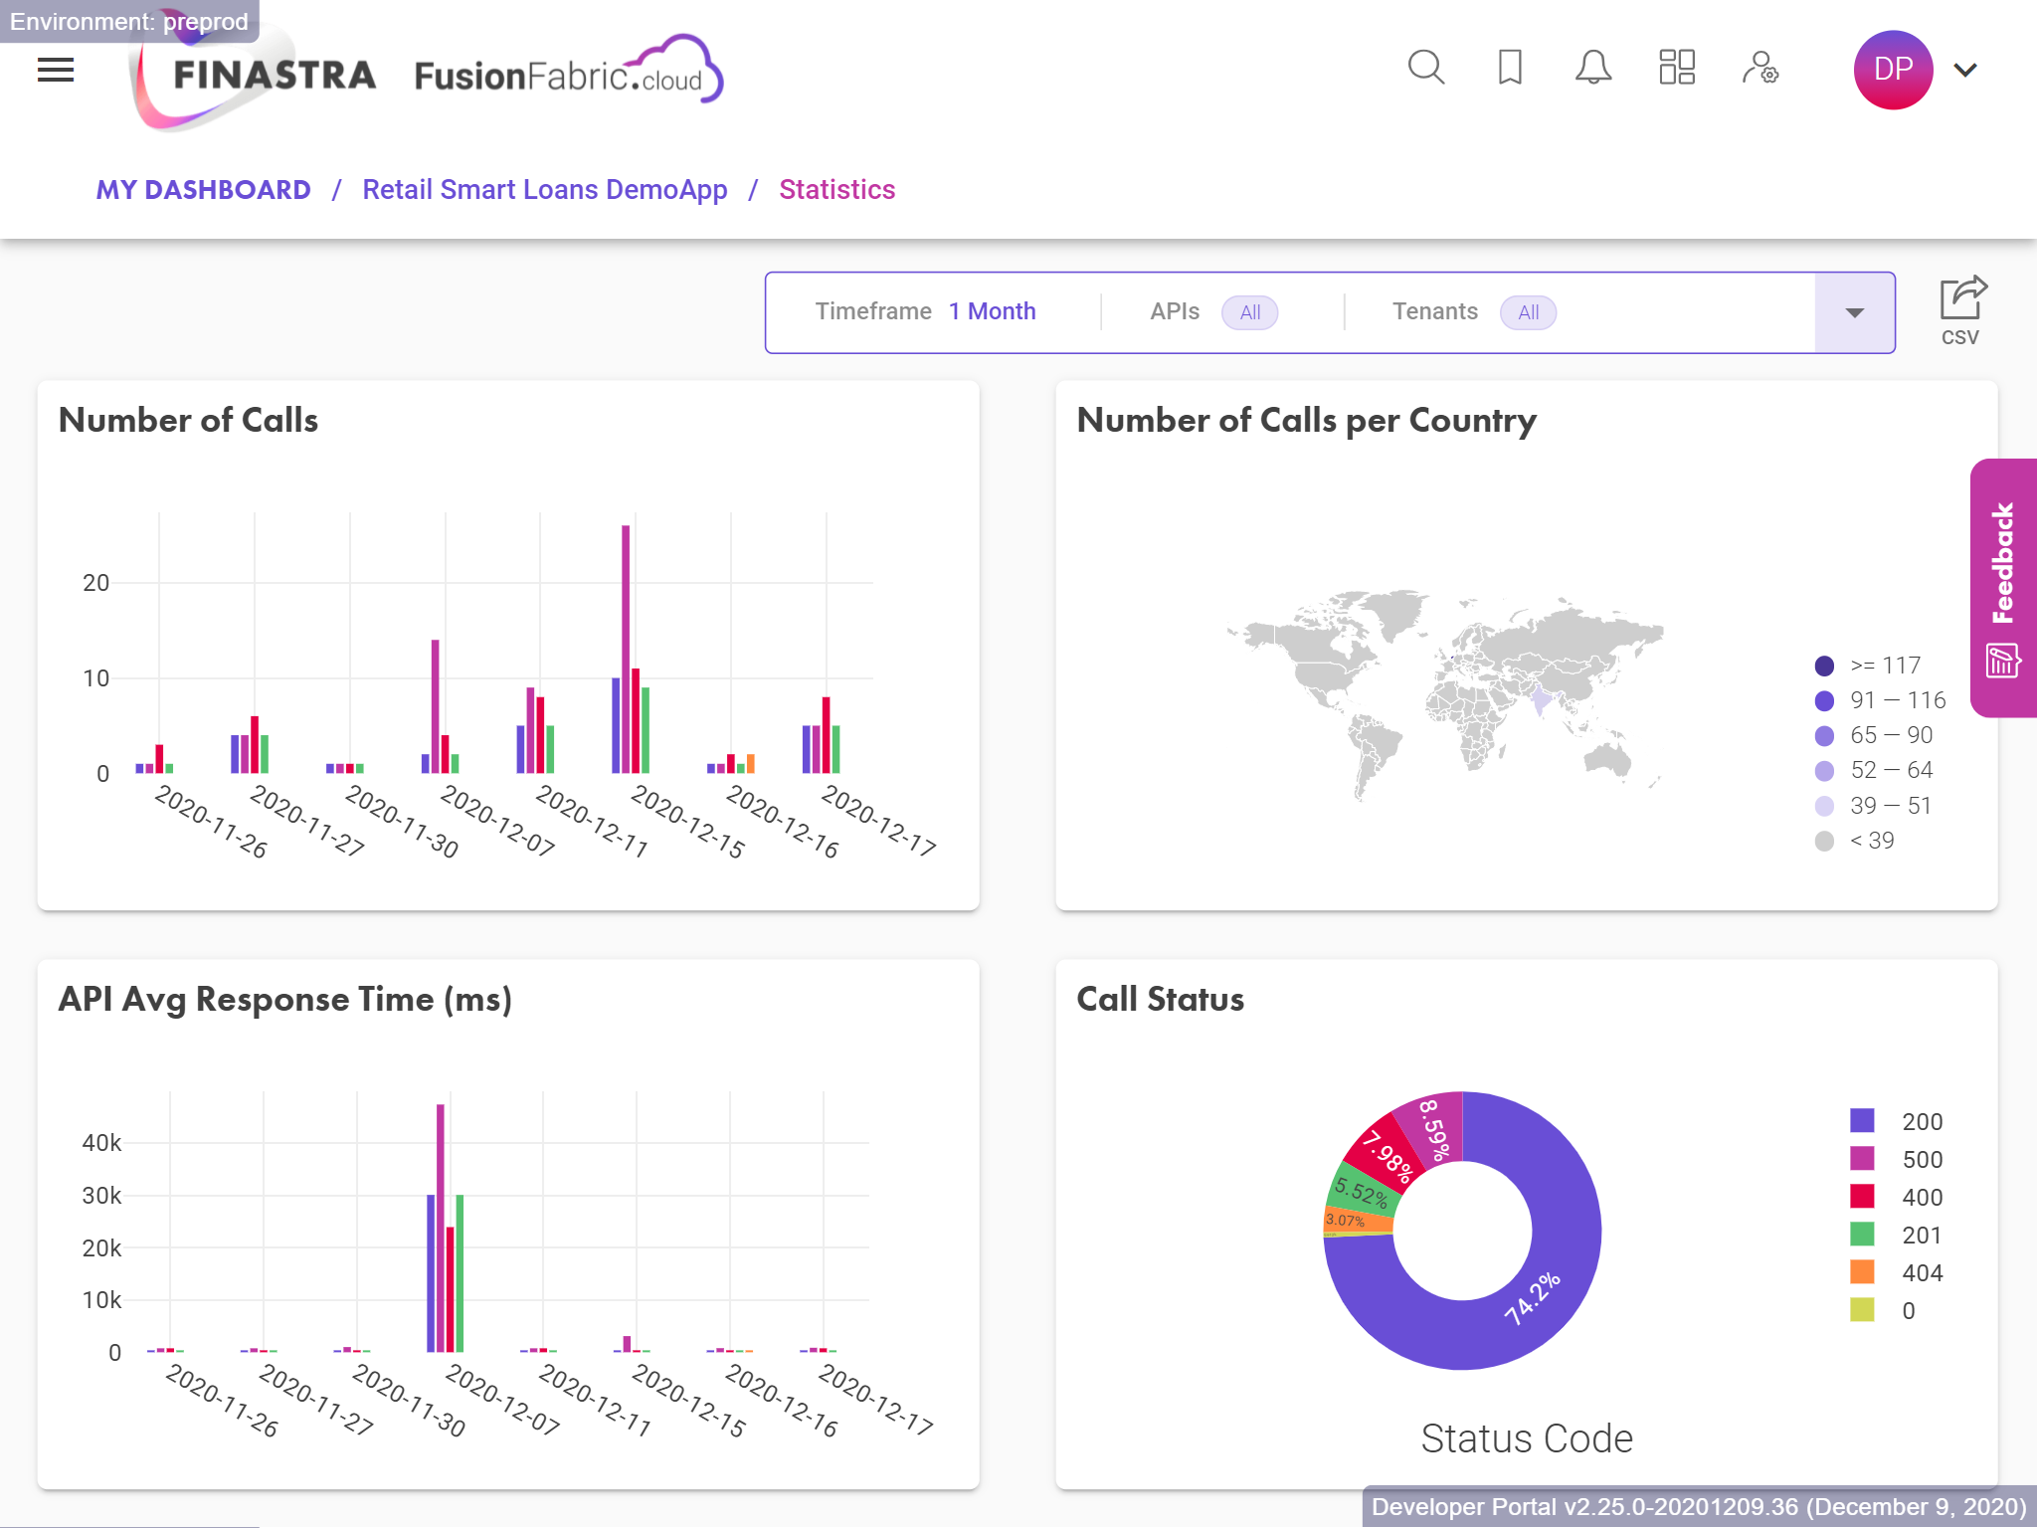
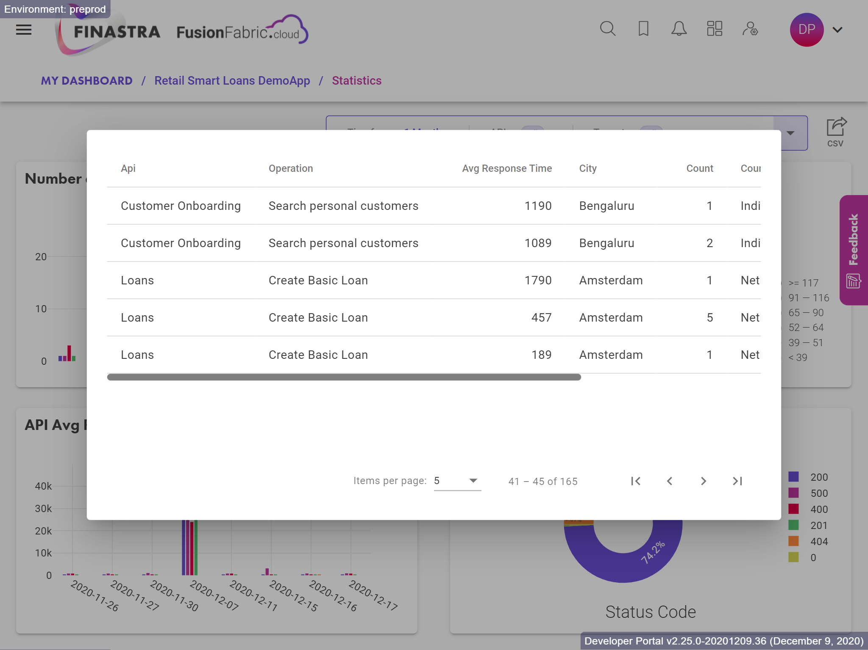
FFDC OPEN APIs Usage | Retail Banking APIs

Slide 10







TEAM H@CK-SL@SH
Cross Functional | Diverse | Retail Banking ROW (Finastra)
Prithumit
Senior Engineering Manager
Hemant
Principal Product Manager
Ramy
Principal Product Manager
Bhaskar N
Senior Software Engineer
Amulya
Software Engineer
Clive Griffin
Director, Product Management

Slide 11
Additional Slides
Fin Smart-Lend Idea – HackToTheFuture 2020

Slide 12

Fin Smart-Lend
Innovation with PSD2 – Lending Marketplace (Personal Loans) with Best of Breed Solutions
Digital (behind the scenes) Loan Origination
Fin Smart-Lend enables Digital Cashflow Analysis using PSD2 Consent
Direct Insights to Borrower’s Financial Wealth (real time). Eliminates Manual Processing of Salary/Income Statement
Customer Details along with Alternative Data Points viz Smartphone, GPS coordinates for Loan Decisioning
Customers
Loan Request
PSD2
Loan Aggregators
Continuous Monitor of Repayment Stress/Risks
Accounts
Transactions
Historical Credit Ratings are less significant now with current dynamics of COVID-19 crisis. Previous correlations are broken
Fin Smart-Lend uses PSD2 Account Monitoring Consent to enable lenders to monitor Repayment Risks on Loans (Real-time Stress on Accounts)
Lender Banks
Loan Offers
Payment Providers
Collaborate as a Lender Bank - Opportunity
Fin Smart-Lend creates a platform to connect customers with multiple Lender Banks for comparative Loan Offers
Lender Banks get PSD2 Consent to access customer’s Financial Information (real time) to determine Loan Eligibility and Personalized Offers

